Slide 1
Adverbs

Slide 2
Types of adverbs
Manner
Frequency
Time and place
Relative time
Degree
Quantity
Focusing
Attitude markers
Carefully, slowly
Always, often, never
Now, here
Already, recently, soon
Extremely, rather, very
A lot, a little
Even, also, only, particularly
Apparently, fortunately

Slide 3
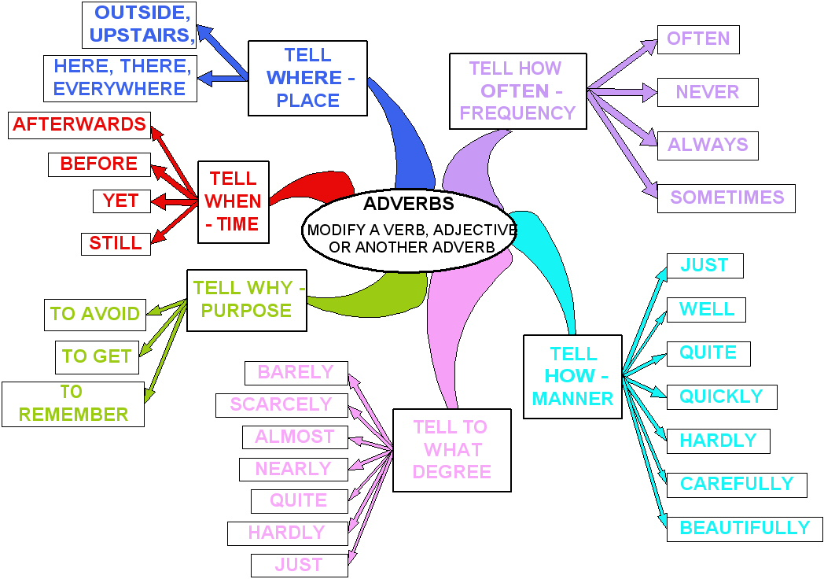

Slide 4
Adverbs of place
Definition
Adverbs of place
Adverbs of place describe where something happens. Most adverbs of place are also used as prepositions. Some commonly used examples include the following:
E.G.I wanted to go upstairs.
She has lived in the city since June. (in the city  prepositional phrase)
outside somewhere there underground upstairs.
abroad anywhere downstairs here home in nowhere out

Slide 5
Adverbs of purpose
Definition
Adverbs of purpose
Adverbs of purpose describe why something happens. Here are some common examples:
E.G. Jenny walks carefully to avoid falling.
Bob accidentally broke the vase.
so so that to in order to because since accidentally intentionally and purposely.

Slide 6
Adverbs of frequency
Definition
Adverbs of frequency
Adverbs of frequency describe how often something happens. The following adverbs are commonly used in this way:
E.G. Mackenzie gets a ride from her brother every day.
The fish usually swims near the top of its tank.
always every never often rarely seldom sometimes and usually.

Slide 7
Adverbs of time
Definition
Adverbs of frequency
Adverbs of time describe when something happens. These examples are commonly used:
E.G. He came home before dark. It will be too dark to play outside soon.
Jessica finished her supper first. Andy left school early.
after already during finally just last later next now recently soon then tomorrow when while and yesterday.

Slide 8
Some adverbs often get overused, such as very, extremely, and really. Using there is/are or it is at the beginning of a sentence adds nothing. Sentences with these adverb phrases become wordy, boring, and less clear. Look at some examples:
There are many bird species living in the sanctuary. Many bird species live in the sanctuary.
It is important to hold hands when crossing the street. Holding hands when crossing the street is important.
* There may be more than one way to solve the problem. The problem may be solved in more than one way.

Slide 9
Adverbs of completeness
Adverbs of Completeness
Everywhere
here
there

