Slide 1
Comparatives and Superlatives
English Grammar

Slide 2
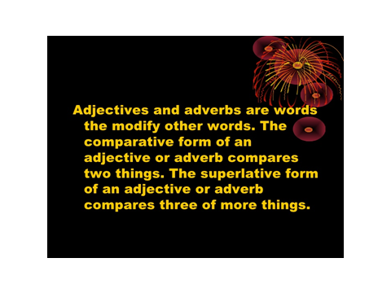
Explanation

Slide 3
Comparative: One syllable adjective
John is tall

Slide 4

Comparative: One syllable adjective = Add er
John
Mario

Slide 5
Comparative: One syllable adjective
John is tall
but Mario is taller than John.
John is shorter/smaller than Mario
Rule: You add ER when comparing heights

Slide 6

Superlative: One syllable adjective = add est
John
Mario
Sam

Slide 7
Superlative: One syllable
John is tall
Mario is taller than John
Sam is the tallest of the three

Slide 8
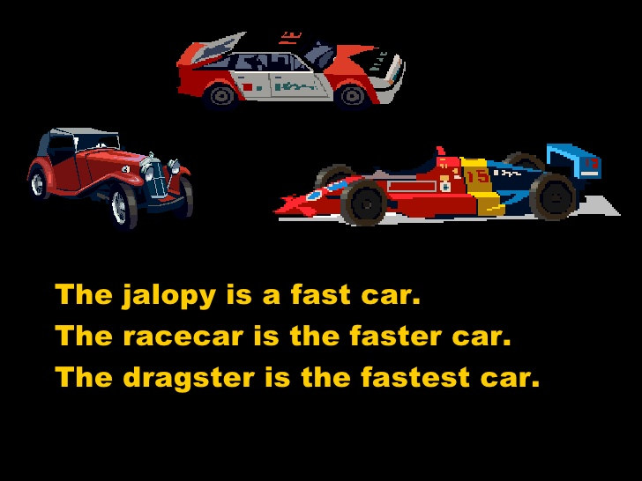
Summary

Slide 9
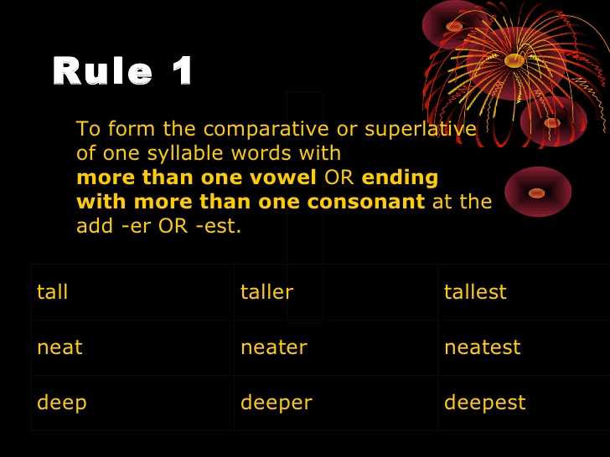
Rules

Slide 10
One Syllable Adjective
More Examples:
Old, older, oldest
Long,longer, longest
Soft, softer, softest
Sweet, sweeter, sweetest
Smart, smarter, smartest
Young, younger, youngest
Cold, colder, coldest
Light, lighter, lighest
Deep, deeper, deepest

Slide 11
Examples
Mary is taller than Max.
Mary is the tallest of all the students.
Max is older than John.
Of the three students, Max is the oldest.
My hair is longer than your hair.
Max's story is the longest story I've ever heard.

Slide 12
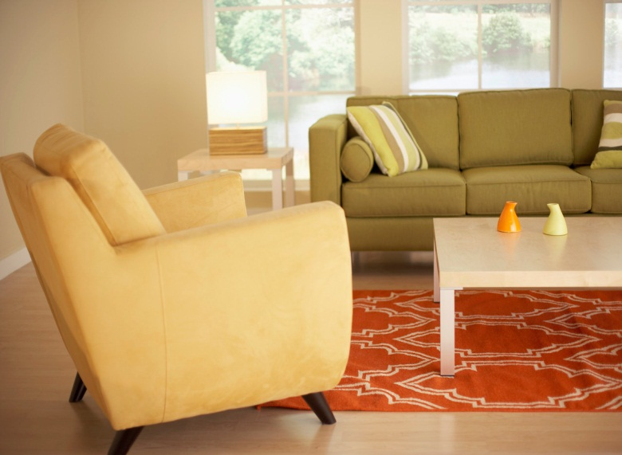
Comparative: One syllable adjectives ending in e just add on r
Example Nice, Wide,
The green sofa (couch) is nice

Slide 13
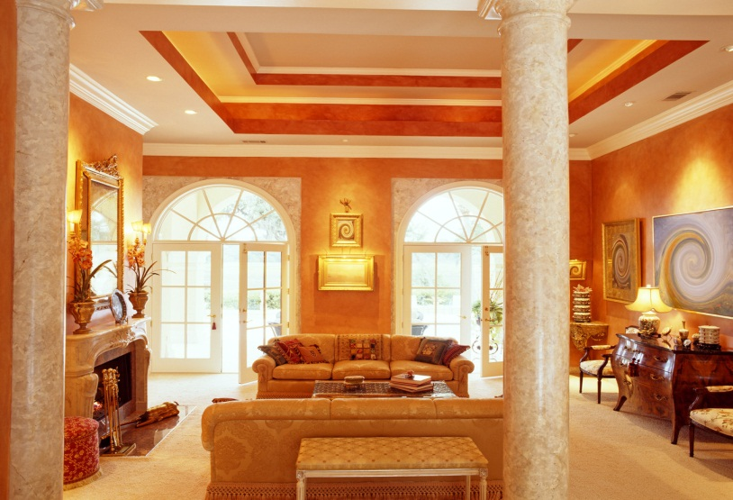
Comparative: One syllable adjectives ending in e just add on r
Example Nice, Wide,
The green sofa (couch) is nice but the brown sofa(couch) is nicer than the green one. It is also wider than the green one.

Slide 14
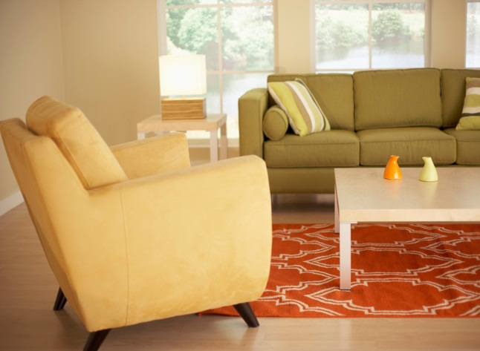

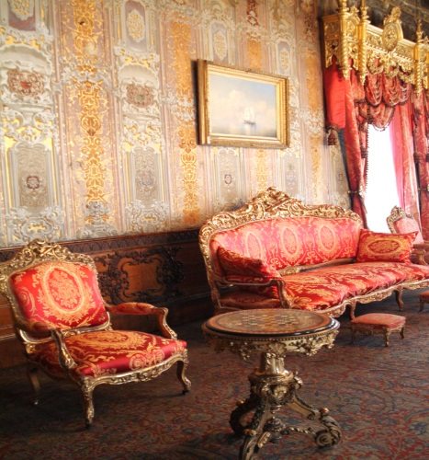
Superlative: One syllable adjectives ending in e just add on st
Example Nice, Wide,
The green sofa (couch) is nice but the brown sofa(couch) is nicer than the green one. It is also wider than the green one.
but the red sofa is the nicest of the three

Slide 15
Examples of One Syllable Adjectives ending in E
Wide, wider, widest
Fine, finer, finest
Cute, cuter, cutest
Large, larger, largest
White, whiter, whitest

Slide 16
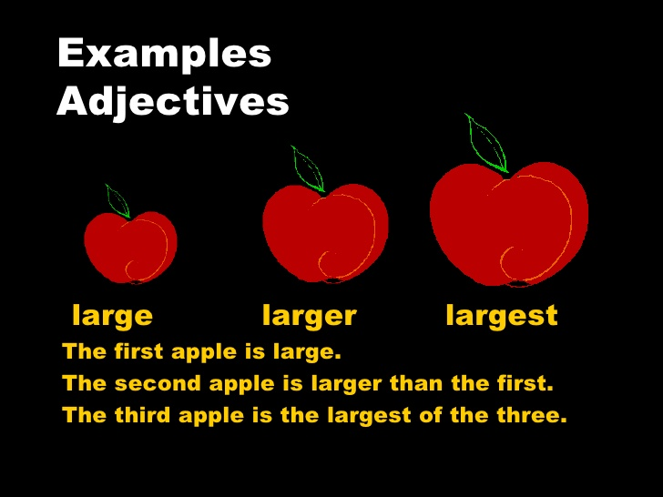
Summary

Slide 17
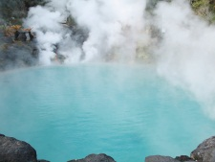
Comparative One syllable adjectives ending in consonant-vowel-consonant
The weather in can be hot
but the weather in
Rule: Double the last letter and add er/est
is hotter
than May
Rule: You double the last consonant and add er

Slide 18
Comparative One syllable adjectives ending in consonant-vowel-consonant
October is a wet month
but November is a wetter month than October
November is the wettest month of the year but July is the hottest month of the year
Rule: You double the last consonant and add er

Slide 19
Examples of Consonant/Vowel/Consonant
Big, bigger, biggest
Fat, fatter, fattest
Slim, slimmer, slimmest
Thin, thinner, thinnest
Sad, sadder, saddest

Slide 20
To discuss feelings: 2 syllable adjectives you replace y with I
Comparative
To talk about feelings you change y to I and add er (Sorry, happy,)
I am happy when I visit a friend, but I am happier when it is her birthday
Superlative
I am happy when I am on holiday, but I am the happiest when I travel to a new place.
Y changes to I and add est
Notes:
With many two syllable we can choose whether to use more or most
able, clever, common, frosty, happy
Adverbs: promptly, quickly, thinly – she stood up most promptly
Adjectives that are the same as present and past participles e.g. boiling, boring, damaged, freezing, needed, smiling
Adjectives that end such as al, ant, ard, ate, ect, ed, en, ful, id, ite, ive, less, ous, some (crucial, dominant, awkward, separate, perfect, gifted, wooden, recent, careful, candid, finite, expensive, careless, gorgeous, loathsome)
The most crucial thing is to arrive on time.

Slide 21
Examples: Y changes to I
Friendly, friendlier, the friendliest
Happy, happier, the happiest
Angry, angrier, the angriest
Lucky, luckier, the luckiest
Pretty, prettier, the prettiest
Jolly, jollier, the jolliest
Lazy, lazier, the laziest
Unhappy, unhappier, the unhappiest

Slide 22
Two Syllable Adjectives & Adverbs
Rule: With many two syllable words e.g. clever, common, frosty, happy) we can choose whether to use more/most or to add er/est to make the comparative and superlative forms.
Are you feeling happier/more happy?
Adverbs that end in ly (e.g. promptly, quickly, thinly)
She stood up most promptly.

Slide 23
Most Common Two Syllable Adjectives
Common | Commoner/more common | The commonest/most common
Narrow | Narrower/more narrow | The narrowest/ the most narrow
Pleasant | Pleasanter/more pleasant | The pleasantest/ the most pleasant
Useless | More useless | The most useless
Simple | Simpler/more simple | The simplest/ the most simple
Quiet | Quieter/more quiet | The quietest/the most quiet

Slide 24
Three Syllable Adjectives
Adjectives that are the same as present or past participles (e.g. boiling, boring, damaged, freezing, needed, smiling).
Today’s lecture was more boring than usual.
Adjectives that have ‘typical’ adjective endings such as al, ant, ard, ate, ect, ed, en, ent, ful, id, ite, ive, less, ous, some (e.g crucial, dominant, awkward, separate, perfect, gifted, wooden, recent, careful, candid, finite, expensive, careless, gorgeous, loathsome e.g.The most crucial thing is to arrive in good time

Slide 25
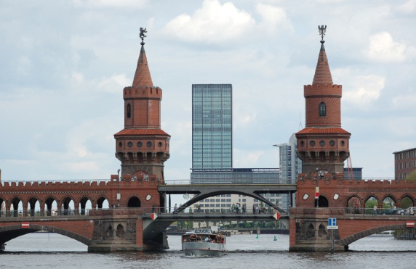
Comparative of two or more syllables
Berlin is a beautiful city
Rule: Use “more” + the adjective
but
Paris is more beautiful than Berlin

Slide 26

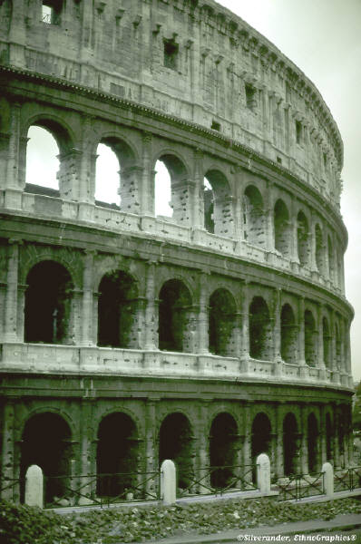
Superlative of two or more syllables
Paris is a very beautiful city but in my opinion Rome is the most beautiful city
Expensive, interesting,

Slide 27
More/Most
Worried | More Worried | The most worried
Boring | More boring | The most boring
Careful | More careful | The most careful
Beautiful | More beautiful | The most beautiful
Peaceful | More peaceful | The most peaceful
Thoughtful | More thoughtful | The most thoughtful
Useless | More useless | The most useless
Expensive | More expensive | The most expensive
Dangerous | More dangerous | The most dangerous
Difficult | More difficult | The most difficult
Exciting | More exciting | The most exciting
Ridiculous | More ridiculous | The most ridiculous

Slide 28
Irregular Comparative & Superlatives
Adjective/Adverb | Comparative | Superlative | Comments
Good | Better | Best
Well | Better | Best
Bad | Worse | Worst | We can also say more/most badly
Far | Farther Further | Farthest Furthest | We use farther and farthest to refer to distance. Further and furthest have abstract meaning (e.g. I don’t want to discuss this any further
Old | Elder | Eldest | Old and older are the standard forms. We use elder and eldest only to talk about family relationships and only normally before a noun e.g. We say my elder brother but not my brother is elder than me).

Slide 29
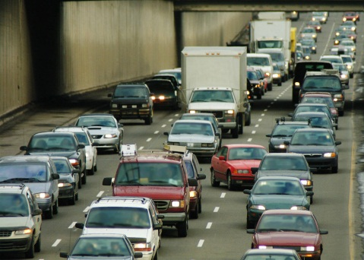
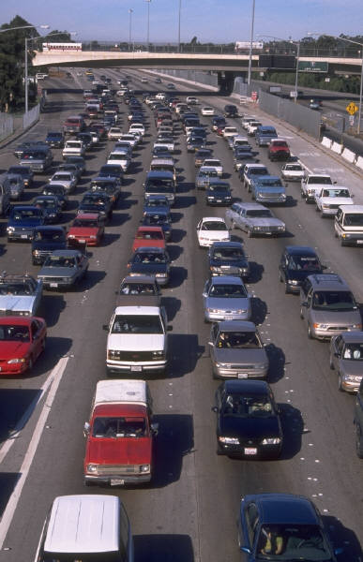
Irregular Comparative Adjectives
The traffic in London is bad
but in my opinion the traffic in Rome is worse (comparative)
The traffic in London is better than the traffic in Rome

Slide 30
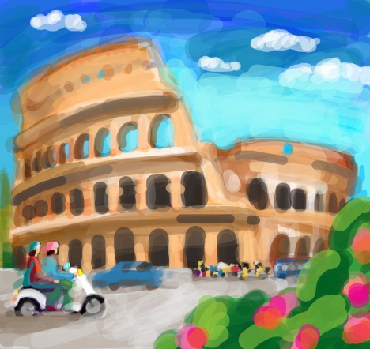
Irregular Superlative Adjectives
They say the traffic in Rome is the worst in the world but it’s the best place to visit in Italy.

Slide 31
Comparisons of Expressions of quantity
More
Most
Fewer
Fewest
Less
Least
Quantity: We can count or measure

Slide 32
Expressions of quantity
E.G. There are more people in Irish prisons than there were in 1990.
Many European cities have problems of traffic congestion but Athens is supposed to have the most problems
Fewer and fewer school leavers want to study classics.
I have the least financial expertise

Slide 33
Irregular Comparative & Superlatives
Quantifier | Comparative | Superlative
A lot/much/many | more | most
A few | fewer | fewest
A little | less | least
We use most, fewest and least in expressions with have
I have the least financial expertise

