Slide 1
Connectors & Conjunctions

Slide 2
Addition
Alternative
Cause-Effect
Comparison
Condition
Contrast
Emphasis
Place
Time

Slide 3
Subordinate Conjunctions
They connect a dependent clause and an independent clause and establish a relationship between them. They happen at the beginning of a sentence (with a comma in the middle separating the clauses) or in the middle of a sentence with no comma.
after | if | though | although
if only | till | as | in order that
unless | as if | now that | until
as long as | once | when | as though
rather than | whenever | because | since
where | before | so that | whereas
even if | than | wherever | even though
that | that | while

Slide 4
Linking Adverbs and Transition Words:
accordingly | however | nonetheless | also
indeed | otherwise | besides | instead
similarly | consequently | likewise | still
conversely | meanwhile | subsequently | finally
moreover | then | furthermore | nevertheless
therefore | hence | next | thus

Slide 5
Contrast
Contrast
However
In contrast
Nevertheless
Nonetheless
Yet
On the other hand

Slide 6
Contrast
By comparison
On the contrary
Instead
In any case
All the same

Slide 7
CONTRAST
1. HOWEVER
This restaurant has the best kitchen in town. However, their staff are quite rude.
2. IN CONTRAST
House prices have gone up this year. In contrast, car prices seem to be stagnating.
3. NEVERTHELESS
I was in so much pain I didn’t want to get up in the morning. Nevertheless, I went to football practice as usual.
4. NONETHELESS
I don’t think Sean has serious behavioural problems. Nonetheless, I’ll talk to him first thing in the morning.
5. YET
I’ve asked you a thousand times not to leave your dirty socks on the floor. Yet, you keep doing it.
6. ON THE OTHER HAND
Ireland has the best language schools. On the other hand, it has the worst weather.

Slide 8
7. BY COMPARISON
Going out with Jim has its risks. By comparison, being with Tim is as easy as falling off a log.
8. ON THE CONTRARY
I don’t hate Jim. On the contrary, I’m rather fond of him.
9. INSTEAD
I didn’t want to take a side in the argument. Instead, I put my headphones on and listened to some smooth jazz.
10. IN ANY CASE
I was thinking of going round Jim’s place. In any case, I haven’t been invited.
11. ALL THE SAME
Yes, he’s very good-looking. All the same, I don’t think you should go out with him.

Slide 9
SIMILARITY
Likewise
Similarly
Correspondingly
In the same way
also

Slide 10
1. LIKEWISE
You can’t give your phone number to every man who asks for it. Likewise, you can’t go out with everyone who fancies you.
2. SIMILARLY
You’re not allowed to use your phone here. Similarly, you have to switch it off when you’re in the library.
3. CORRESPONDINGLY
She’s an excellent photographer. Correspondingly, her paintings are works of art.
4. IN THE SAME WAY
Cutting down on sugar will help you lose weight. In the same way, doing more exercise will help you get rid of a few kilos.
5. ALSO
I want to talk to Prince Harry when I’m in England. Also, I want to meet his sister-in-law.

Slide 11
Result
As a result
As a consequence
Therefore
Thus
Accordingly

Slide 12
1. AS A RESULT
I’ve done a panic healing course. As a result, I’ve been able to cure my neighbour’s sick cat.
2. AS A CONSEQUENCE
Zack has skipped school on many occasions. As a consequence, he’s failed his French test.
3. THEREFORE
We’re going to experience some meteor showers in the next few days. Therefore, the number of miraculous self-healings will rise.
4. THUS
You didn’t tell me you wanted to come. Thus, we won’t be taking you with us.
5. ACCORDINGLY
Plenty of tourists visit the area in summer. Accordingly, selling hand-made objects is the main source of income for locals.

Slide 13
The difference between connectors and conjunctions
CONNECTORS
My mum used to come and collect me from college. What’s more she would let me drive when we went shopping.
A sentence connector links one sentence with another e.g. (what’s more) links one sentence with another.

Slide 14
Sequencing
1. FIRST, FIRSTLY, FIRST OF ALL, IN THE FIRST PLACE
First of all, I’d like to talk about the benefits of having a pet pig.
2. TO BEGIN WITH
To begin with, pet pigs are cleaner than dogs.
3. FOR ONE THING
For one thing, they’re completely loyal to their owners.
4. SECOND, SECONDLY, IN THE SECOND PLACE
Secondly, their impressive numeracy skills must be mentioned.
5. FOR ANOTHER THING
For another thing, you might want to consider how cute they look in pyjamas.
6. THIRD, THIRDLY, IN THE THIRD PLACE
In the third place, you can always count on your pet pig to perform some tricks for you when you’d like to impress a pretty girl.

Slide 15
PARTICULARIZATION
1. IN PARTICULAR, PARTICULARLY
Nearly a third of marriages end in divorce. In particular, it’s middle-aged couples that yearn for much more from life.
2. MORE SPECIFICALLY
Couples tend to argue about financial issues. More specifically, they argue when one of them is out of work.

Slide 16
EXAMPLIFICATION
1. FOR EXAMPLE
To solve this problem, you might want to try making small gestures. For example, making your spouse’s favourite meal for dinner or going out to your favourite restaurant.
2. FOR INSTANCE
Appreciate the small things your spouse does for you. For instance, leave thank-you notes for them every now and then.
3. TO ILLUSTRATE
Misunderstandings can be highly destructive. To illustrate, if you don’t listen careful you get the wrong end of the stick about an important matter.

Slide 17
ORDER OF IMPORTANCE
1. MOST IMPORTANTLY
I’d like to talk to you about how to keep calm at your workplace. Most importantly, never go to the canteen while your boss is there.
2. PRIMARILY
You’ll have to focus on your immediate surroundings. Primarily, on your computer screen.
3. ABOVE ALL
Above all, don’t ever look up from your notes when people are around.
4. MOST SIGNIFICANTLY
Most significantly, avoid eye-contact at all costs.
5. ESSENTIALLY, BASICALLY (usually spoken)
How can I put this? Essentially, falling in love with one of your colleagues should be the last thing on your mind.

Slide 18
7. ALSO
Also, they don’t eat much.
8. BESIDES
Besides not eating much, they won’t ever chew on your electric cords.
9. IN ADDITION
In addition, they can be taught to feed themselves if you allow them access to your pantry.
10. FURTHERMORE
Furthermore, they make wonderful walking buddies.
11. MOREOVER
Moreover, they’ll show you the way home when you’re drunk.
12. FINALLY
Finally, pet pigs are fantastic guards. No burglar would ever have the heart to hurt a pet pig.
13. LAST, LASTLY, LAST OF ALL
Lastly, your reputation as an eccentric will rapidly grow in the neighbourhood if you’re seen walking a pet pig on a leash every morning.

Slide 19
EXPLANATION
1. THAT IS TO SAY, THAT IS
Keep romance alive. That is to say, don’t let your love life fall into routine.
2. NAMELY
I have a very good reason for not trusting my ex. Namely, he’s a convicted felon.
3. IN OTHER WORDS
Don’t be unsociable. In other words, go out and make some friends.
4. PUT DIFFERENTLY
John has managed to get over Jane. Put differently, he’s started seeing other women.

Slide 20
EMPHASISING
1. AS A MATTER OF FACT
I love sleeping with my pet pig. As a matter of fact, I can’t fall asleep unless he’s in my bed.
2. IN FACT
I told them not to invite Rachel to the party. In fact, I was the only person who saw what a party pooper she really was.
3. ACTUALLY
I think it would be a good idea to send her some flowers. Actually, you should get her a hundred orchids.
4. INDEED
He may be the best-dressed man around. Indeed, he has a really good taste in fashion.

Slide 21
FOCUSING AND LINKING
1. AS FOR (often suggests disinterest or dislike)
I’m going to Janet’s party at the weekend. As for Mary’s, I think I’ll pass.
2. WITH RESPECT TO
Starting your own IT company may be the one of the best things you can do right now. With respect to opening a pet shop, it’s hard to say the same thing.
3. REGARDING
Start your day with making the most important phone calls. Regarding emails, you might put them off until later.
4. WITH REGARD TO
With regard to handling complaints, you might want to keep in mind that your customers are always right.

Slide 22
5. AS REGARDS
Working from home has many advantages. As regards disadvantages, it might be difficult to keep your cat off your keyboard.
6. TALKING OF
Talking of cats, you can’t trust them to keep you company when you need it. They’re quite selfish creatures.
7. AS FAR AS … CONCERNED
As far as dogs are concerned, they might give you a chance to get up from your desk and get some exercise during the day.

Slide 23
CONCLUSION
1. IN CONCLUSION
In conclusion, it may be said that pigs make the best pets.
2. IN BRIEF
Meeting my boss at the pub was an interesting experience. In brief, it was a disaster.
3. IN SUMMARY
In summary, it may not be the best idea to frequent the same pubs as your boss.
4. TO SUM UP
To sum up, some people are better suited to working from home than others.
5. ALL IN ALL
All in all, you have to make sure both you and your customers are satisfied with your work.

Slide 24
CORRECTION
1. RATHER
I thought it was a good idea to get a ferret. Rather, it had always been my dream to get one.
2. TO BE MORE PRECISE
You might want to change a few things. To be more precise, I think you should start again from scratch.

Slide 25
TIME
1. AT FIRST
It wasn’t a piece of cake to learn English. At first, I couldn’t pronounce all the words correctly.
2. THEN
Then, I couldn’t spell all the words correctly.
3. AFTERWARDS
Afterwards, I had a hard time understanding the tenses.
4. LATER
Later, I couldn’t memorize phrasal verbs and idioms.
5. IN THE MEANTIME
In the meantime, I was getting some help from MyEnglishTeacher.
6. MEANWHILE
Meanwhile, I was enjoying my skype lessons more and more.

Slide 26
DISMISSAL (of what was said before)
1. ANYWAY
I couldn’t get my head around the Passive Voice. Anyway, I don’t think it’s important to use it all the time.
2. ANYHOW
Anyhow, I’ve just decided to learn Russian next.
3. AT ANY RATE
At any rate, I don’t want to become a simultaneous interpreter in five languages.

Slide 27
The difference between connectors and conjunctions
CONJUNCTIONS
My mum taught me to drive because I couldn’t afford to pay for driving lessons.
  A conjunction (because) links clauses within a single sentence

Slide 28
Although Conjunction
To link two clauses we use only one conjunction.
  Although it is expensive having driving lessons, I would really recommend it.
We usually put a comma between clauses linked by a conjunction.
  As long as I didn’t do anything stupid, she stayed calm.
  When because or while (referring to time) begin the second clause in the sentence we don’t need a comma

Slide 29
Connectors
Sentence connectors usually come at the beginning of a sentence.
The only ones that can’t come at the beginning are: too, and as well
  You can spend a lot more time practising, as well
We usually put a comma after a sentence connector at the beginning or end of a sentence.
  My mum thought I was ready to take my driving test. However, I failed first time.

Slide 30
There are lots of advantages in having your parents teach you. There is the cost, for instance.
  When a connector comes elsewhere in the sentence the punctuation is more varied.
  My instructor was very experienced and, as a result, he had lots of useful tips to pass on.

Slide 31
BEFORE & UNTIL (CONJUNTIONS)
Sometimes they can mean the same
  She wouldn’t let me drive on busy roads before/until I could control the car well.

Slide 32
Until
We use until and not before to highlight that a particular action continues until a certain time and then stops.
  I just carried on having driving instructions until my driving instructor said I was ready to take the driving test.

Slide 33
Hardly, Scarcely, No sooner - Conjunctions
After hardly and scarcely the second clause usually begins with when or before
  We had hardly driven out of our road before we were shouting at each other
After no sooner the second clause begins with than or when
  I had no sooner passed my test then/when my friends started asking me for lifts.
We normally use a past perfect with hardly, scarcely, and no sooner and a past simple in the other clause

Slide 34
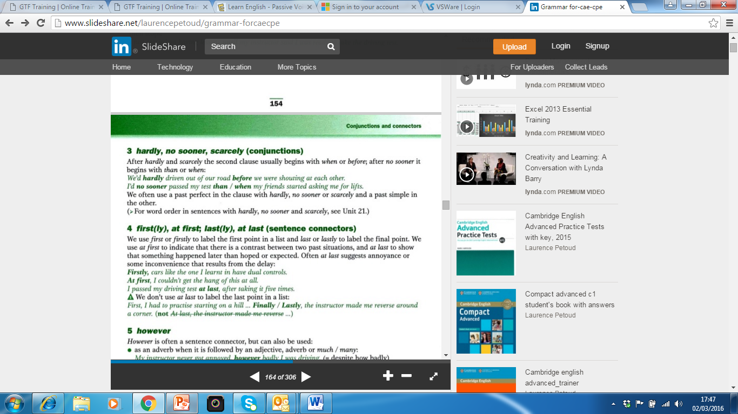

Slide 35
However
However, is often a sentence connector but can be used as an adverb when followed by an adjective, adverb, or by much or many
  My instructor never got annoyed, however badly I was driving (despite how badly).
As a conjunction when it means “in whatever way” However I had the mirror positioned, I couldn’t judge where the back of the car was.

Slide 36
Even so (connector), Even though (conjunction)
Even so has a meaning similar to however.
We use it to introduce a fact that is surprising given what has been said.
  He was great and I didn’t want to be taught by anyone else. Even so, I found the replacements very patient and helpful.
We use even though to say that a fact doesn’t doesn’t make the rest of the sentence untrue
  Even though she has no qualifications, she has got lots of experiences to pass on.

Slide 37
On the other hand, on the contrary
We use on the other hand when we compare or contrast two statements. We sometimes introduce the first statement with on the one hand.
  It may be that the quality of the tuition is better with a professional driving instructor. On the other hand it is cheaper if your parents teach you
  Or On the one hand it may be that the quality of the tuition is better with a professional driving instructor. On the other hand it is cheaper if your parents teach you.

Slide 38
On the contrary
On the contrary is used in the same way as on the other hand but we reject the first statement and accept the second.
  Some people say that it is more expensive to be taught by a driving instructor than by a friend. On the contrary, it works out cheaper.

Slide 39
Prepositions confused with connectors and conjunctions
As well as
Besides
Apart from
Despite
In spite of
Due to
During

Slide 40
As well as being calm and patient, he was always encouraging.
Apart from the cost of the insurance, I think it is much better to be taught by your parents.
I think there is a lot of other good things about having your parents teach you, besides saving money.
I would recommend driving lesson despite/in spite of the cost (expense)
Notes:
Unit 17 http://www.slideshare.net/laurencepetoud/grammar-forcaecpe

Slide 41
The lesson was cancelled due to the heavy rain.
We used to stop driving at some point during the lesson and he would ask me how I felt I had improved.

