Slide 1
Kinds of Sentence:

Slide 2
Kinds of Sentences:
Sentences can be classified into five categories according to the meaning or function(s).
They are:-
1.Assertive Sentence.
2.Interrogative Sentence
3.Imperative Sentence
4.Operative Sentence.
5.Exclamatory Sentence.

Slide 3
Assertive Sentence:
Assertive Sentence:
An assertive sentence is a simple statement or assertion, either affirmative or negative.
Pattern: Subject + verb + Object/complement/adverb Example: -English is an International Language. (Affirmative) -We do not do bad things. (Negative) -Everybody should know English. (Modal auxiliaries)

Slide 4
Interrogative Sentence:
An interrogative sentence is a sentence that asks a question
about some person or things and ends with a question mark (?).
There are two ways to form an interrogative sentence.
I. Begins with helping verbs (am, is, are, was, were, have, had) or modal auxiliaries (shall, should, will, would, can, could, may, might etc.). Example: - Do you have your assignment ready? - Does he speak English? - Did she work abroad? - Should I go there? - Can you hear the sound? - Don’t you want any food? (Negative)

Slide 5
Interrogative Sentence:
2. Begins with some specific words like who, which, what, when, where, why, how, whom, how much, how many. These are known as ‘WH’ questions. Example: - How is your business going on? - Who fixed the computer? - Whom do you support? - What are you expecting from me? - What time is it now? - How many people have died there?

Slide 6
Imperative Sentence:
A sentence that expresses a request, command, order, advice, suggestion is an imperative sentence. In an imperative sentence, subject is usually unexpressed, it is understood.
Pattern: Subject (Invisible) + verb + object / where Example: - Take care of yourself. - Give me the pen. - Do it now. - Be honest. - Come here - Never tell a lie - Do not laugh at others’ helplessness. - Let him go there.

Slide 7
Operative Sentence:
Wish, desire, prayer are expressed by the Optative sentence.
Pattern: May + Assertive Example: - May you live long. - Wish you all the best. - Long live the king (can be formed without ‘may’)

Slide 8
Exclamatory Sentence:
Exclamatory is a sentence which expresses strong/sudden feeling or emotion like surprise, pain, delight, anger, disgust etc.
Alas/ Hurrah/ Bravo/ What/ How etc. + Others Example: - Hurrah! Our cricket team has won the series. - Alas! He lost the race. - Bravo! You have done a great job. - What a talented girl she is! - How sweetly the cuckoo sings! - What a wonderful country Ireland is! - Were I a Super Hero! - What a pity! - Fantastic! - What an idea! - Put that down, now! - Leave the package at the door. - Walk softly, please.

Slide 9
Structure of a Sentence:
There are three types of sentences.
A Simple Sentence. B Complex Sentence. C. Compound Sentence.

Slide 10
Simple Sentences:
A Simple sentence is structured with only one subject and one finite verb. A simple sentence has only one independent clause.
Pattern: Subject + finite verb + complement Example:
- China is a very populated country.. - Life is not a bed of roses - Humans are superior beings on this planet.

Slide 11
Summary: Simple Sentence
A simple sentence has only one clause:
The children were laughing.
John wanted a new bicycle.
All the girls are learning English. -

Slide 12
Complex Sentences:
B. A sentence consisting of one principal clause and one or more sub-ordinate clauses is a complex sentence.
Example: - If you work hard, you will shine in life. (Here, ‘if you work hard’ is sub-ordinate clause and ‘you will shine in life’ is Main or principal clause)
Sub-ordinate clause begins with conjunctions like who, which, that, when, how, where, while, if, whether, because, since, as, though, although, till, until, unless, before, after, so that, whenever, wherever, whoever, whatever etc.

Slide 13
Complex Sentences:
Example: - I know where he lives. - I do not know what his name is. - While there is life there is hope - We eat so that we can survive.

Slide 14
Summary Complex Sentences
Complex sentences: A complex sentence has a main clause and one or more adverbial clauses.
Adverbial clauses usually come after the main clause: Her father died when she was very young >>> Her father died (main clause) when (subordinating conjunction) she was very young (adverbial clause) -

Slide 15
Summary Complex Sentences
She had a difficult childhood because her father died when she was very young. >>> She had a difficult childhood (main clause) because (subordinating conjunction) her father died (adverbial clause) when (subordinating conjunction) she was very young (adverbial clause). -

Slide 16
Summary Complex Sentences
Some subordinate clauses can come in front of the main clause: Although a few snakes are dangerous most of them are quite harmless>>> Although (subordinating conjunction) some snakes are dangerous (adverbial clause) most of them are harmless (main clause).

Slide 17
Summary:
A sentence can contain both subordinate and coordinate clauses:
Although she has always lived in France, she speaks fluent English because her mother was American and her father was Nigerian >>> Although (subordinating conjunction) she has always lived in France (adverbial clause), she speaks fluent English (main clause) because (subordinating conjunction) her mother was American (adverbial clause) and (coordinating conjunction) her father was Nigerian (adverbial clause).

Slide 18
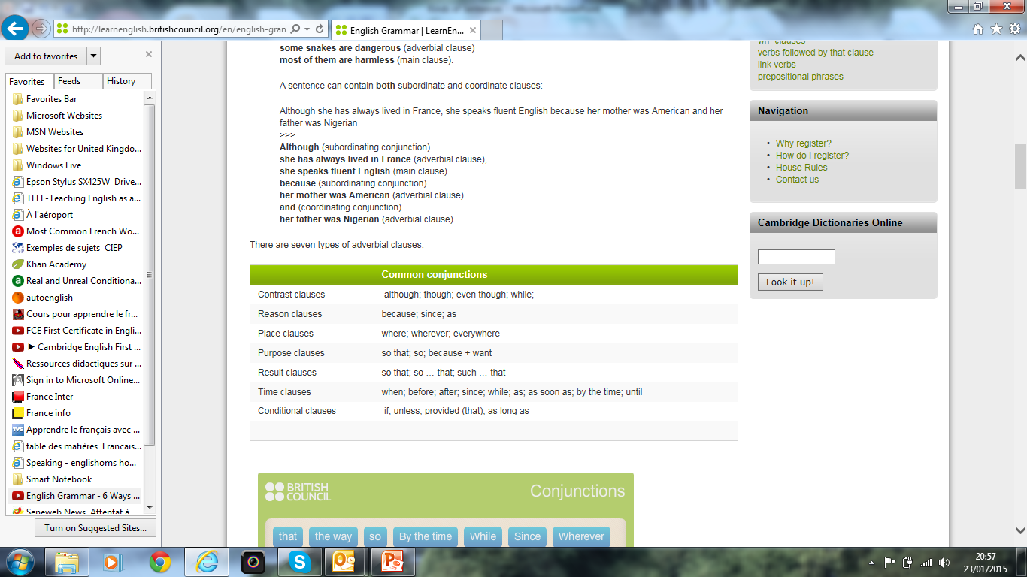

Slide 19
Compound Sentences:
C. A sentence having more than one principal clauses linked by one or more coordinating conjunctions preceded by a comma is called compound sentence.
Conjunctions are used in compound sentences are and, but, or, for, nor, also, however, moreover, thus, so, therefore, else, still, as well as, accordingly, otherwise, yet, not yet, but also, either or, neither nor, on the contrary etc.
Example: - Respect others, and others will respect you. - He loves us, but he does not show it.

Slide 20
Summary Compound Sentences
Compound sentences: A compound sentence has two or more clauses: (We stayed behind) and (finished the job) (We stayed behind) and (finished the job), then (we went home)

Slide 21
Summary Compound Sentences
The clauses in a compound sentence are joined by co-ordinating conjunctions: John shouted and everybody waved. We looked everywhere but we couldn’t find him. They are coming by car so they should be here soon. The common coordinating conjunctions are: and – but – or – nor – so – then – yet -

