Slide 1
Superstitions

Slide 2

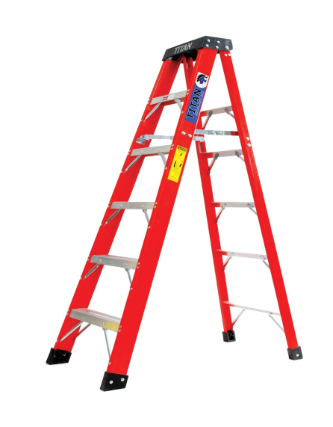

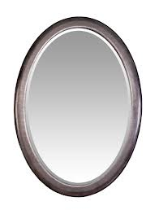

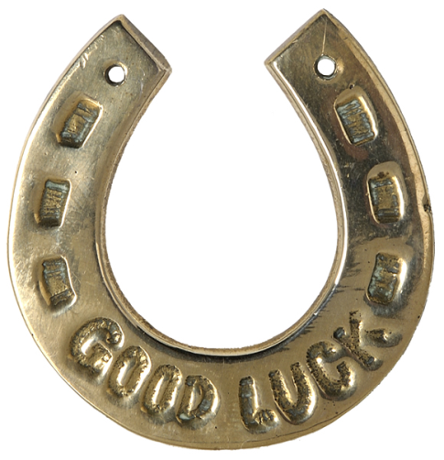
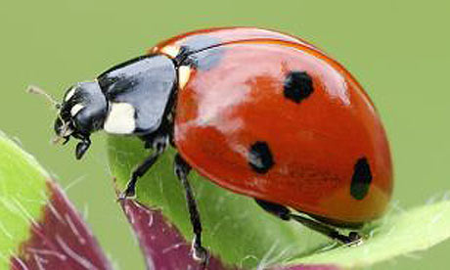
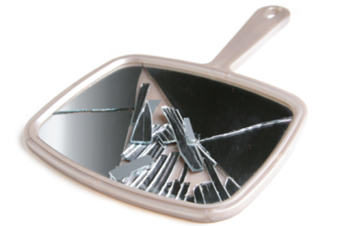

Slide 3

BLACK CAT
If a black cat crosses your path, you will have good luck.

Slide 4
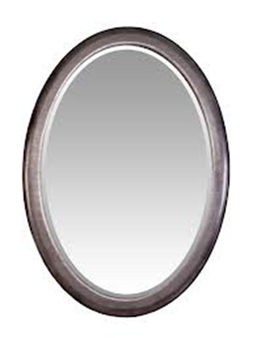

MIRROR
If you break a mirror, you will have seven years’ bad luck

Slide 5

LADYBIRD
If you see a ladybird, you will have good luck.

Slide 6

HORSESHOE
If you pick up a horseshoe, you will have good luck.

Slide 7

RAINBOW
If you see a rainbow, you will have good luck.

Slide 8

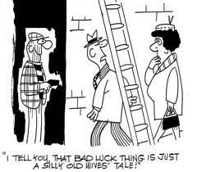
LADDER
If you walk under a ladder, you will have bad luck.

Slide 9

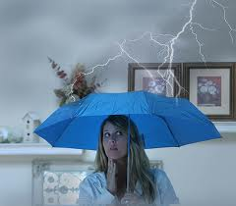
UMBRELLA
If you open an umbrella indoors, you will have bad luck.

