Slide 1
Which Verbs Take to after them
Listen, write, explain, speak, talk, say to (someone)
Explain, write, send, describe something to someone

Slide 2
VERBS+ TO= Someone
Listen
Write
Explain
Speak
Talk
Say
SOMEONE

Slide 3

TO LISTEN TO
Listen to me, I have something important to say
I love listening to other people’s conversations
Are you listening to my conversation?

Slide 4

TO WRITE TO
Please write to me soon
I shall write to you next week
Write a letter to the principal telling her you misbehaved in class.

Slide 5
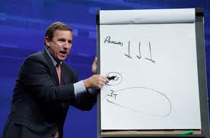
TO EXPLAIN TO
The man is explaining the diagram to the students
I shall explain the problem to you
I explained to my friend how the internet works

Slide 6
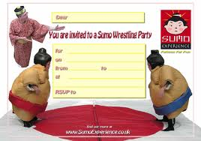
TO INVITE TO
I am going to invite my friends to the party.

Slide 7
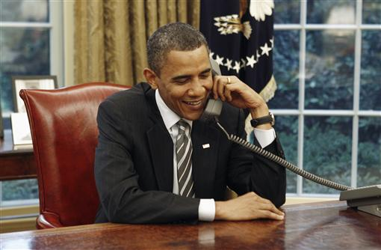
TO SPEAK TO/WITH
I speak to my friend every day
The president is speaking to the Russian president
Do you speak English or Japanese to your host family?

Slide 8

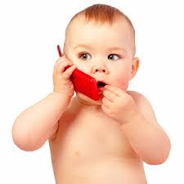
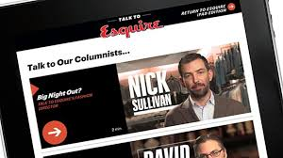
TO TALK TO/WITH
This baby can’t be talking to his mother he is too young.

Slide 9



SAY TO (someone)
Say “yes” or “no”
My mother said to me that I should have been careful

Slide 10
Something to someone
Explain
Write
Send
Describe
I shall explain the problem to you when I see you
We are going to write about this problem to the Minister

Slide 11
NO PREPOSITIONS AFTER: TELEPHONE,TELL, ASK(someone)
I didn’t telephone my parents because I couldn’t find my mobile
Tell her I am sick
I often ask the teacher questions
Tell me about your holiday in Spain

Slide 12
NO PREPOSITIONS AFTER: WRITE, SEND, ASK (SOMEONE SOMETHING)
Ask her about last night’s party
I often ask the teacher many questions
My mother didn’t send me a postcard from Italy.
I send text messages to my friends
The teacher said good-bye to us.

Slide 13
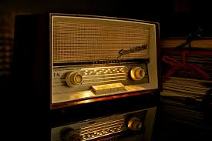


Want/Would like+TO
WANT + To
WOULD LIKE + To
I want to buy a radio
You would like to go for a walk/Perhaps you would like to go for a walk

Slide 14
TO after Would love/would hate/would prefer
WOULD LOVE + To
WOULD HATE+ To
WOULD PREFER+To
I would love to improve my English
You would hate to eat there. The food isn’t nice.
Would you prefer to travel by car or train?

Slide 15
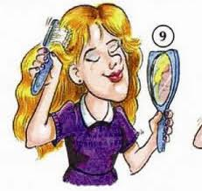

We can use to+verb or verb + ing with
Like
Love(I love swimming)
Hate (I hate cooking)
Prefer (I prefer to eat meat/I prefer eating meat
I like to brush my hair in front of the mirror or
I like brushing my hair in front of the mirror
However, we say: Would you like to use not would you like using…….

Slide 16
VERBS THAT TAKE TO+ VERB AFTER THEM
Want
Like
Decide
Expect
Forget
Hope
Learn
Need
Plan
Try
Promise
We can also use nouns or noun phrases after all these verbs e.g. I want a new radio

Slide 17
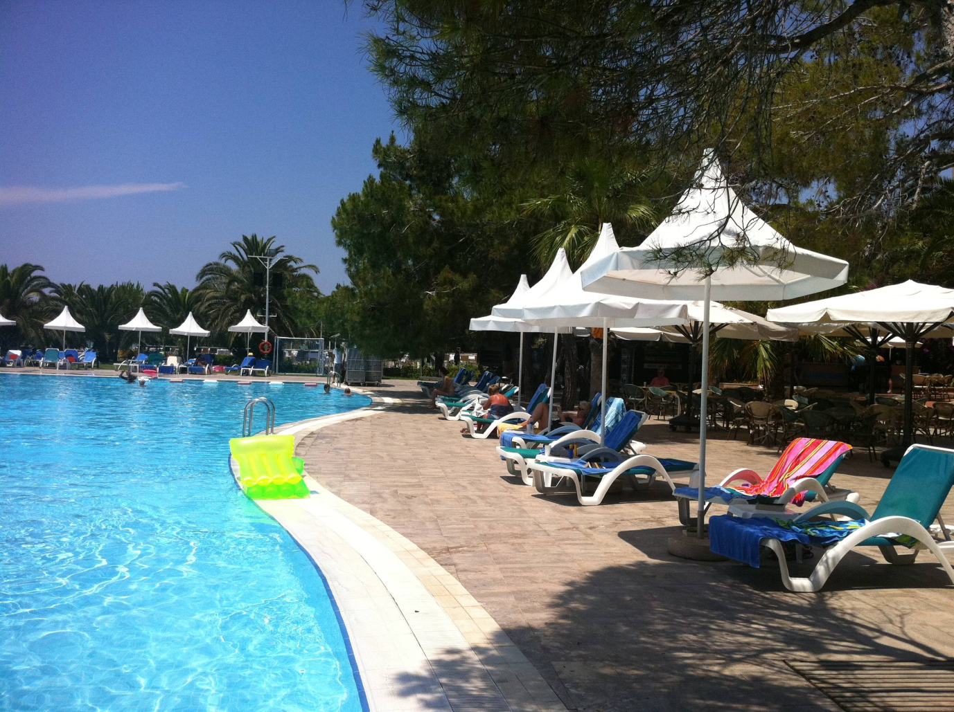
WANT + TO + Verb
During my holiday I want to relax

Slide 18

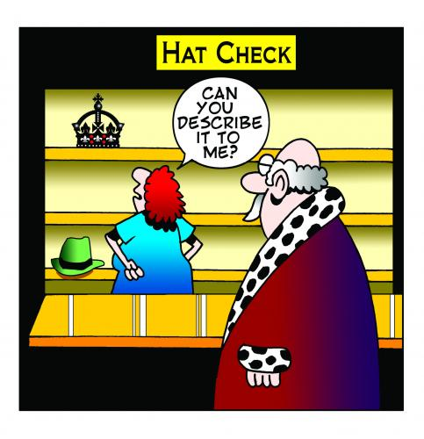

DESCRIBE +TO+Verb
We say I would like to describe my house to you/Describe your typical day to me

Slide 19

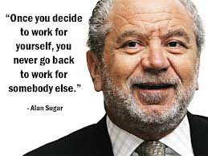
Decide + TO+Verb
Decide to work for someone

Slide 20
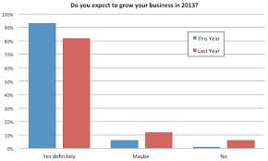
EXPECT + TO+VERB
Do you expect to grow your business in 2013

Slide 21
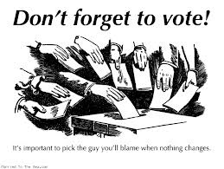

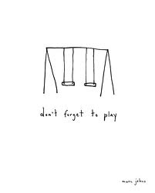
FORGET + TO+VERB

Slide 22




HOPE + TO+VERB

Slide 23

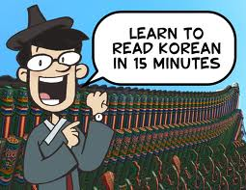

LEARN + TO+VERB

Slide 24



NEED + TO+VERB

Slide 25


PLAN + TO+VERB

Slide 26


PROMISE + TO+VERB

Slide 27


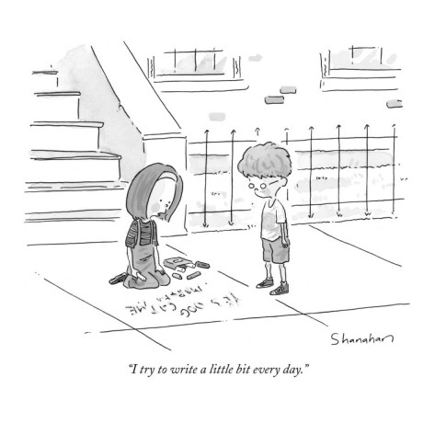
TRY + TO+VERB

