Slide 1
Voc

Slide 2
Campaign
A connected series of military operations forming a distinct phase of a war
2. A connected series of operations designed to bring about a particular result e.g an <election campaign>

Slide 3
Examples of CAMPAIGN
The group launched a campaign to protect the area from commercial development.
The university is organizing a campaign to attract a more diverse student population.

Slide 4
Key Words (Culmination)
The final result of a process or culmination
Noun
The highest or climactic point of something, esp. as attained after a long time
Synonyms
climax - zenith - acme - summit - meridian - peak - apex

Slide 5
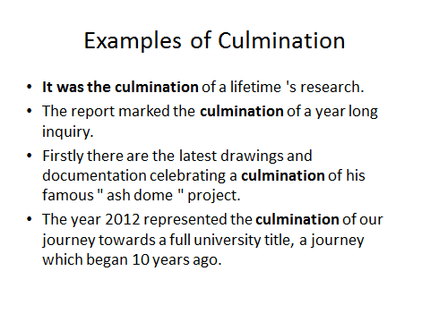

Slide 6
Determination
noun
The quality of being determined; firmness of purpose:
Examples:
Those who succeed because of sheer grit and determination
2. His leadership qualities and determination to challenge capitalism earned him lasting respect from all who knew him, particularly in his role as union steward and factory convenor.

Slide 7
Influence
noun
The capacity to have an effect on the character, development, or behaviour of someone or something, or the effect itself:
Examples:
the influence of television violence is…….
I was still under the influence of my parents
Their friends are having a bad influence on his behaviour.
Synonymseffect, impact; control, sway, hold, power, authority, ascendancy, mastery, domination, supremacy, leadership; guidance, direction,

Slide 8
Influence
The power to shape policy or ensure favourable treatment from someone, especially through status, contacts, or wealth
The institute has considerable influence with teachers
This is because people involved in corruption include those with higher status, political influence and economic power.
Gold might bring power, wealth and influence, but it has wrecked as many lives as it has made.

Slide 9
Key Words (Militants)
People who use extreme and violent methods to achieve something.
Adjective
Combative and aggressive in support of a political or social cause: "militant fundamentalists".
Noun
A person who is active in this way

Slide 10
Militant
Synonyms
adjective. warlike - bellicose - combative - belligerent - fighting
noun. fighter - combatant - warrior - activist

Slide 11
Struggling
verb
Make forceful or violent efforts to get free of restraint or constriction:
He struggled to break free
2. A struggling team failed to win the match

Slide 12
Struggling
Strive to achieve or attain something in the face of difficulty or resistance:
New authors are struggling in the present climate
Many families on income support have to struggle to make ends meet

Slide 13
Struggling
(struggle with) Have difficulty handling or coping with:
Passengers struggle with bags and briefcases

Slide 14
Key Words (Allusion)
A statement or action that refers to something in an indirect way.
Noun
An expression designed to call something to mind without mentioning it explicitly; an indirect or passing reference. 2. The practice of making such references, esp. as an artistic device. Example: An allusion to Shakespeare

Slide 15
Key Words (Allusion)
Synonyms
hint - reference - suggestion - innuendo - insinuation

Slide 16
Duty
noun (plural duties)
A moral or legal obligation; a responsibility:
Examples:
It’s my duty to uphold the laws
She was determined to do her duty as a citizen : (a strong sense of duty)

Slide 17
Extremists
A person who holds extreme political or religious views, especially one who advocates illegal, violent, or other extreme action: right-wing extremists
What has driven the people of Europe's most stable country into the hands of political extremists?

Slide 18
To Droop
verb
Bend or hang downwards limply: a long black cloak drooped from his shoulders

Slide 19
Key Words (Traumas)
Serious injuries but also
Noun
A deeply distressing or disturbing experience. Emotional shock following a stressful event or a physical injury, which may be associated with physical shock and sometimes leads to... She had a traumatic experience yesterday her car went out of control and crashed What a trauma you have had, are you alright?

Slide 20
Petition
A formal written request, typically one signed by many people, appealing to authority in respect of a particular cause: Examples
she was asked to sign a petition against plans to build on the local playing fields
I hope Evening Press readers will sign petitions and write to their MPs demanding that these plans to pay benefits directly into banks are scrapped.
Well, I've signed a lot of petitions and written a lot of letters.

