Slide 1
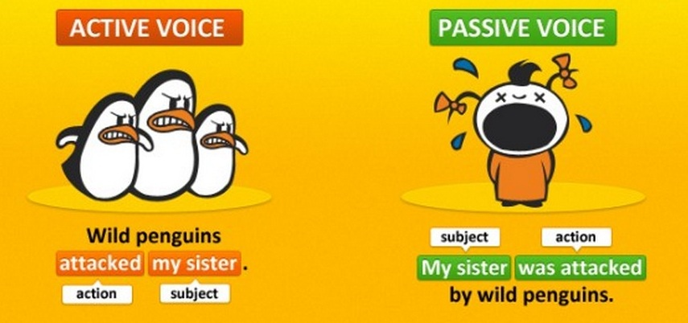
Passive and Active Voices

Slide 2
Verbs are also said to be either active or passive
Active:
The executive committee approved the new policy.
Passive
The new policy was approved by the executive committee)

Slide 3
What’s the difference
In the active voice, the subject and verb relationship is straightforward:
the subject is the doer and the verb moves the sentence along.
In the passive voice, the subject of the sentence is not a doer, but is acted upon by some other agent or by something unnamed
The new policy was approved

Slide 4
USE
When the action is more important than the person or thing doing the action.
We use it when the agent is unknown
The passive is used in more formal situations, such as lectures, academic writing and news reports.

Slide 5
Reporting Information
The passive is used to give ideas or opinions without saying where they come from:
Assume, believe, claim, consider, feel, hope, report, say, think.
We use it + passive (+that) + active clause, where it is an impersonal pronoun that does not refer to a real subject.
It is said that most computer users are women
It is thought that there are 2.5 billion internet users in the world

Slide 6
Reporting Information
3. We can use passive +to+infinitive (usually be)
There is reported to be an increasing threat to our ecosystem.
There are believed to be more than 600 species of trees per hectare in tropical rain forests.
4. Passive+perfect infinitve which indicates that the event has already occurred.
People are said to have begun writing 6,000 years ago
Language is thought to have emerged 50,000 years ago.

Slide 7
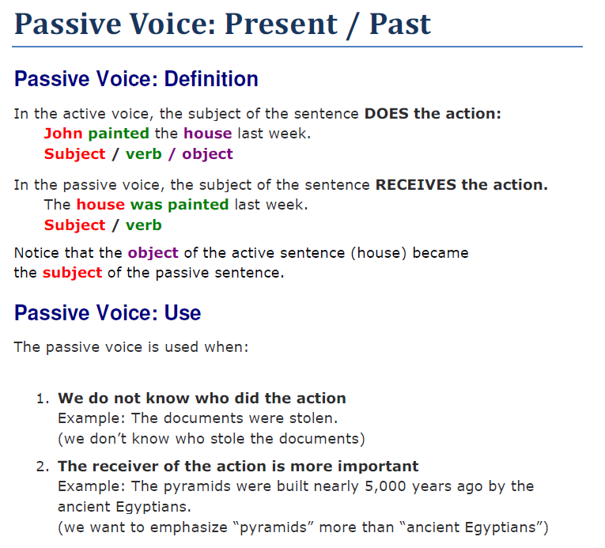

Slide 8
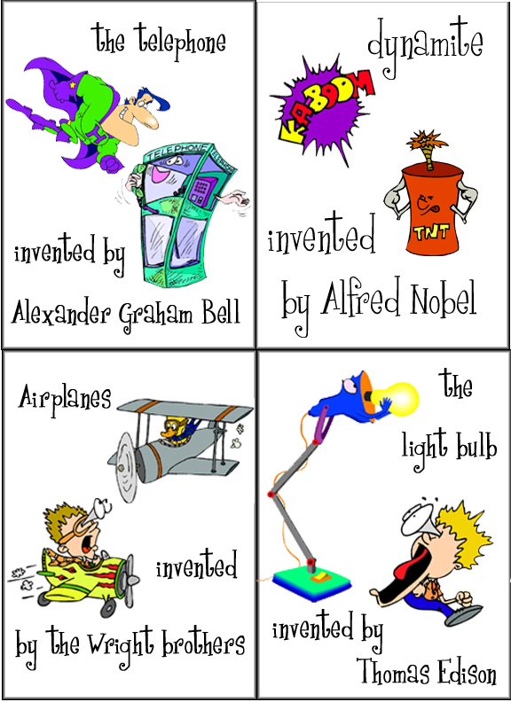

Slide 9
Passive Verb Formation
The passive forms of a verb are created by combining a form of the "to be verb" with the past participle of the main verb.
Other helping verbs are also sometimes present:

Slide 10
Let's take a look at the passive forms of "design."
Tense | Subject | Auxiliary |  | Past Participle
 |  | Singular | Plural
Present | The car/cars | is | are | designed.
Present perfect | The car/cars | has been | have been | designed.
Past | The car/cars | was | were | designed.
Past perfect | The car/cars | had been | had been | designed.
Future | The car/cars | will be | will be | designed.
Future perfect | The car/cars | will have been | will have been | designed.
Present progressive | The car/cars | is being | are being | designed.
Past progressive | The car/cars | was being | were being | designed.

Slide 11
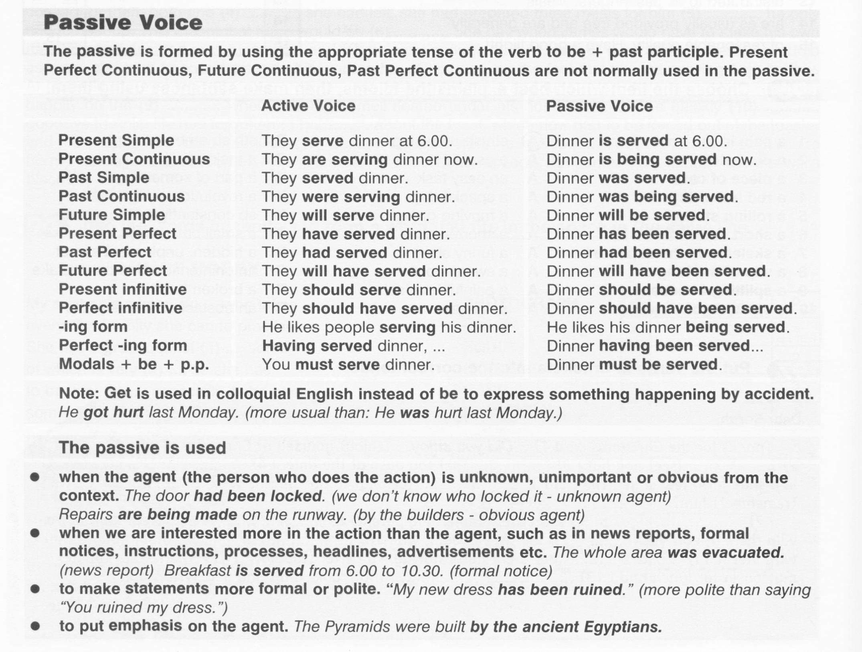

Slide 12
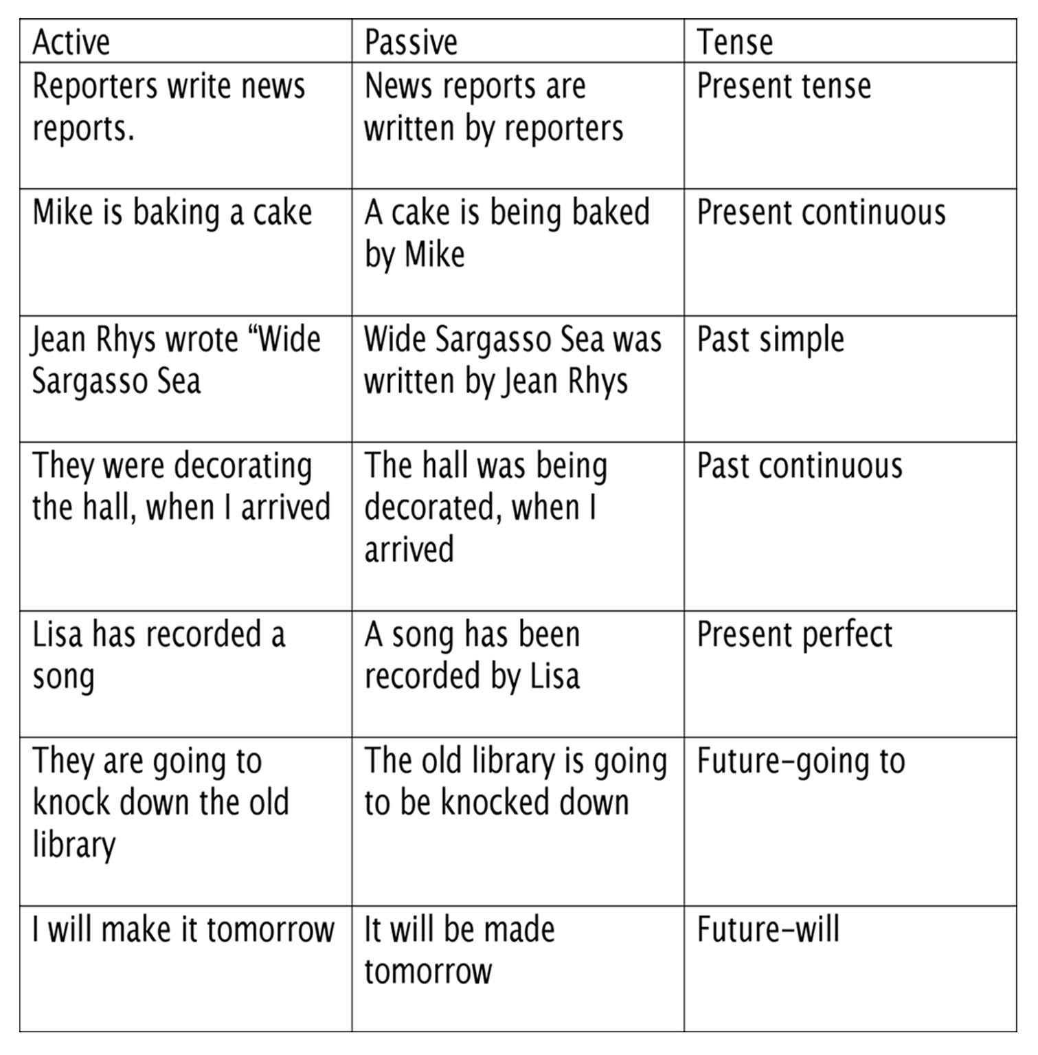

Slide 13
Active | Professor Villa gave Jorge an A.
Passive | An A was given to Jorge by Professor Villa.
Passive | Jorge was given an A.

