Slide 1
Present Tense
Present Simple
Present Continuous
State Verbs

Slide 2
To Work
+ | - | ?
I work | I do not work (I don’t) | Do I work?

Slide 3
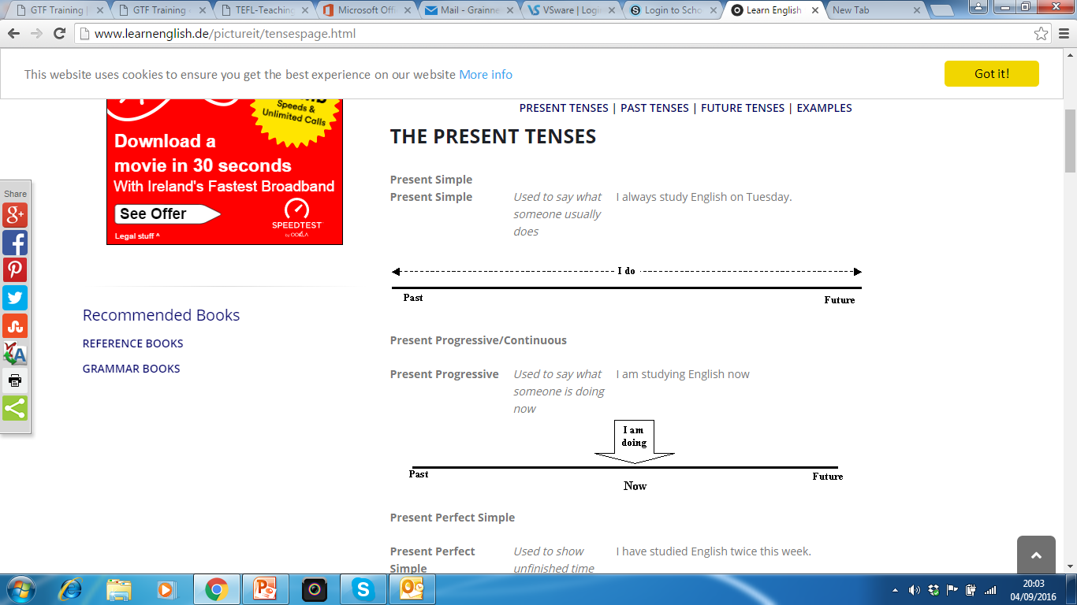

Slide 4
Present Simple
Every verb we study we shall use
+ = Positive
- = Negative
? = Question
+ | Verb/verb + s | She works in London
- | Do/does not + verb | He doesn’t work London
? | Do/does….+ verb? | Where do you work?

Slide 5
To Work
+ | - | ?
I work | I do not work (I don’t) | Do I work?
You work | You do not work ( you don’t work) | Do you work?
He/she/it works | He/she/it/ does not work (it doesn’t work) | Does he/she/it work?
We work | We do not work (we don’t work) | Do we work?
You work | You do not work (you don’t work) | Do you work?
They work | They do not (don’t work) | Do they work?

Slide 6
Use
To say when things happen if they take place regularly:
  They eat lunch at 2 O’clock.
To talk about permanent situations:
  I work in Dublin
To state general truths:
  Those bags sell really fast.
  The moon goes round the earth

Slide 7
Use: Present Simple
4. To talk about habits and how often they happen:
  You buy new clothes every Friday.
To describe the plots of books and films:
  The story begins and ends in Spain. They year is 1937.

Slide 8
Present Continuous
Every verb we study we shall use
+ = Positive
- = Negative
? = Question
+ | am/is/are+verb+ing | He’s working in Dublin this week
- | am/is/are not+verb+ing | I’m not working in Dublin this week
? | am/is/are..+verb+ing? | Are you working in Dublin this week?

Slide 9
To Work- Present Continuous
+ | - | ?
I am working | I am (I’m) not working | Am I working?
You are working | You are (you’re) not working | Are you working?
He/she/it is working | He/she/it is not (isn’t) working | Is she/he/it working?
We are working | We are (we’re) not working | Are we working?
You are working | You are (you’re) not working | Are you working?
They are working. | They are (they’re) not working | Are they working?

Slide 10
Use-Present Continuous
To talk about the present moment:
  I’m wearing a pair of old jeans.
  I’m looking at a blue bag right now.
To suggest that an action is temporary, often with words like now, at the moment, at present or just:
  They’re eating lunch at the moment
  I’m working in London this week (= I don’t usually work in London)

Slide 11
Use-Present Continuous
3. For an action around the time of speaking, which has begun but is not finished:
  I’m cleaning my room
  I’m looking around the shops (Millie isn’t looking round the shops at this moment-she has stopped to talk to Lisa but plans to continue looking round later.)

Slide 12
Use-Present Continuous
For changing or developing situations:
  Navy blue bags are getting really fashionable.
  The earth’s temperature is rising.
5. With a word like always or continually if we want to criticise or complain:
  You’re always buying new clothes! (=you buy too many).
  He’s always complaining about things

Slide 13
Use-Present Continuous
6. With always when something unexpected happens several times:
  I’m always meeting my neighbour John near the station. I guess he works somewhere near there.

